Slide 1



www.kickstarter.com
Crowdfunding Analysis
TEAM MEMBERS: JITESH KUMAR SINGH VESHALA PRIYANJALI SAMARTH S DEVADIGA HARSHITH H M KABERU KARTHIK KUMAR SAI AAKASH PA ROHAN NEGI

Slide 2



INDEX
Crowdfunding Overview
KPI’s Observations
Excel Dashboard
SQL Queries
Power BI Dashboard
Tableau Dashboard
Challenges and Recommendations
Conclusion

Slide 3

Crowdfunding Overview
Crowdfunding is the practice of funding a project
or venture by raising small amounts of money from
a large number of people, typically via the Internet.
Crowdfunding is a form of crowdsourcing and
alternative finance. In 2015, over US$34 billion was
raised worldwide by crowdfunding
Popular Platforms :

Slide 4


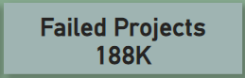



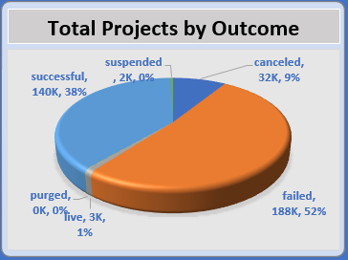
KPI’S Observations
Total number of projects based on outcome :
It shows that a significant portion of projects, 52% (188K), failed, while 38% (140K) succeeded. The remaining projects were either canceled (32K), live (3K), suspended (2K), or purged (0.2K).
The high percentage of failed projects suggests that many initiatives face challenges in reaching their goals. This could be attributed to various factors such as insufficient market research, poor campaign strategy, or lack of planning.
This insights suggest that improving metrics involves better planning for project success and also conduct thorough market research to understand the needs and preferences of potential backers. Maintain regular updates and communication with backers to build trust and support throughout the campaign.

Slide 5
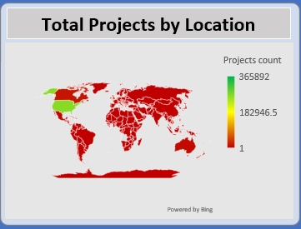
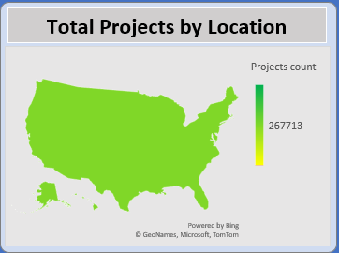
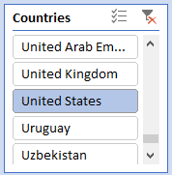
Total number of projects based on locations :
The majority of projects originated in the USA , followed by the UK and Canada. This highlights the strong presence of crowdfunding in North America and Europe, driven by well-established platforms and a large base of potential backers.
The geographic concentration suggests opportunities for growth in underrepresented regions, where emerging markets could benefit from increased platform outreach and support.

Slide 6
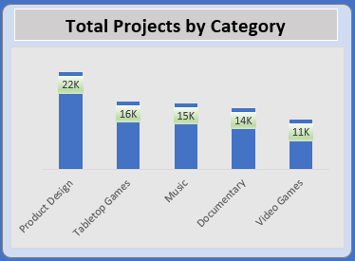
Total number of projects based on category :
The chart illustrates the Top 5 crowdfunding projects across various categories. Product Design leads with 22K projects, followed by Tabletop Games (16K) and music (15K) and so on.
This distribution reflects the popularity and funding potential of innovative and creative projects. High engagement in technology and design indicates a robust interest in cutting-edge solutions and aesthetically driven initiatives.

Slide 7
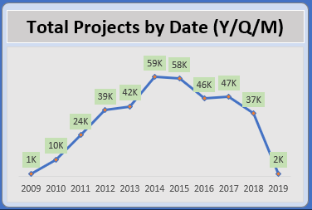
Total number of projects based on Date:
This chart details the annual distribution of crowdfunding projects from 2009 to 2019. A steady increase is observed, with 10K projects in 2010, rising to 59K in 2014.
This upward trend till 2014 underscores the growing acceptance and utilization of crowdfunding as a viable funding mechanism.
The downward trend after 2014 shows decrease in total projects counts may be the reason of insufficient funding on projects or the decreases of successful projects.

Slide 8
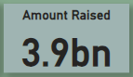
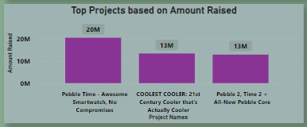
Top successful projects based on amount raised :
The leading project secured $20M, followed by others with $13M and $13M respectively.
These figures demonstrate the potential for significant financial backing when projects resonate well with the community.
Key factors contributing to such success include compelling storytelling, clear value propositions, and effective marketing strategies. High funding amounts reflect strong community support and the ability of projects to capture the imagination and trust of backers.

Slide 9
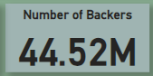
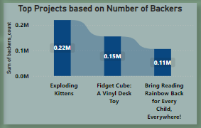
Top successful projects based on number of backers:
The most backers in one project is 0.22M , with subsequent projects attracting 0.15M and 0.11M backers.
These numbers emphasize the importance of community engagement and widespread appeal. Successful projects often leverage social media, influencers, and targeted campaigns to build a broad base of support.
High backer numbers indicate strong community involvement and the viral nature of successful crowdfunding campaigns.

Slide 10
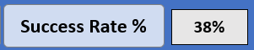
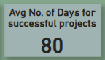
Percentage of successful projects:
This KPI reveals that 38% of crowdfunding projects achieved success. Factors influencing success include project preparation, marketing efforts, and realistic goal setting.
The remaining 62% highlight challenges such as insufficient reach, unmet market needs, and competition.
Avg no. of days for successful projects :
The average duration for successful projects is 80 days. This timeframe suggests that campaigns typically need about a month to gather the necessary support.
Effective time management and strategic planning are crucial during this period. Shorter campaigns might lack sufficient exposure, while excessively long campaigns could lose momentum. A balanced duration allows for sustained engagement and maximizes the chances of reaching the funding goal.

Slide 11
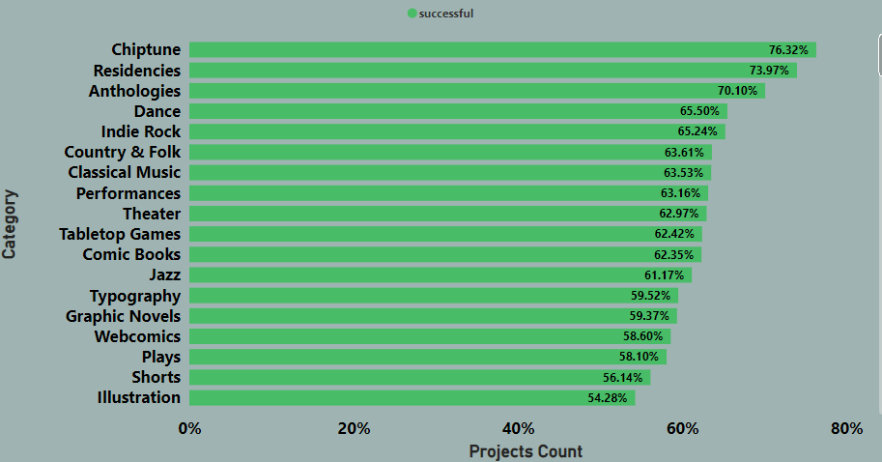
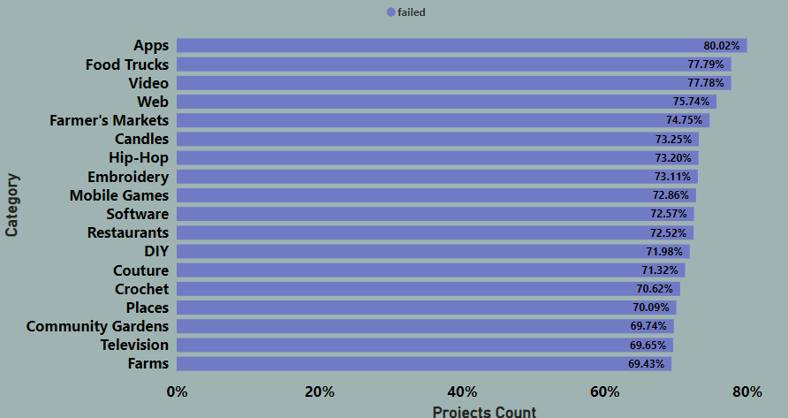
Percentage of successful projects by category:
This chart breaks down the success rates by category, with Chiptune at 76.32%, Residences at 73.97%, Anthologies at 70.10% and so on.
Failed Projects by category, with Apps at 80.02%,Food Trunks at 77.79%, Video at 77.78% and so on.
Higher success rates in these category reflect strong interest and funding potential in these areas.
Tailored strategies to enhance visibility and appeal can help improve outcomes across different category.

Slide 12
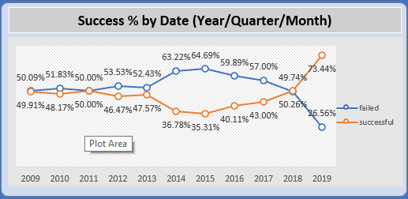
Percentage of successful projects by Date :
Success Rates have gradually increased over the years from 2009 to 2015 and after it decreasing.
The positive trend in initially indicates improvements in campaign quality, platform support, and backers engagement.
The trend going decrease after 2015 because lack of support from backers and insufficient reach and strategic planning for project success.

Slide 13

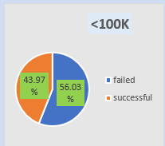
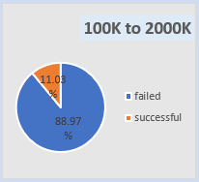
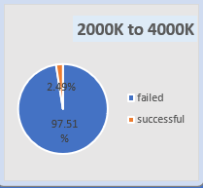
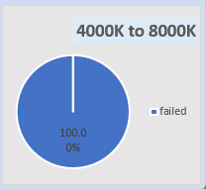
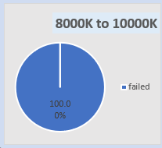
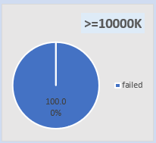
Percentage of successful projects by goal range :
Success rates vary by funding goal range, with smaller goals (less then 100K) achieving a 43.97% success rate, while larger goals (over 10000K) see 0% success rate.
This trend highlights the challenges associated with raising substantial amounts through crowdfunding.
Smaller goals are more attainable and pose less risk for backers, while larger goals require extensive planning, strong promotional efforts, and significant initial support to build momentum.

Slide 14
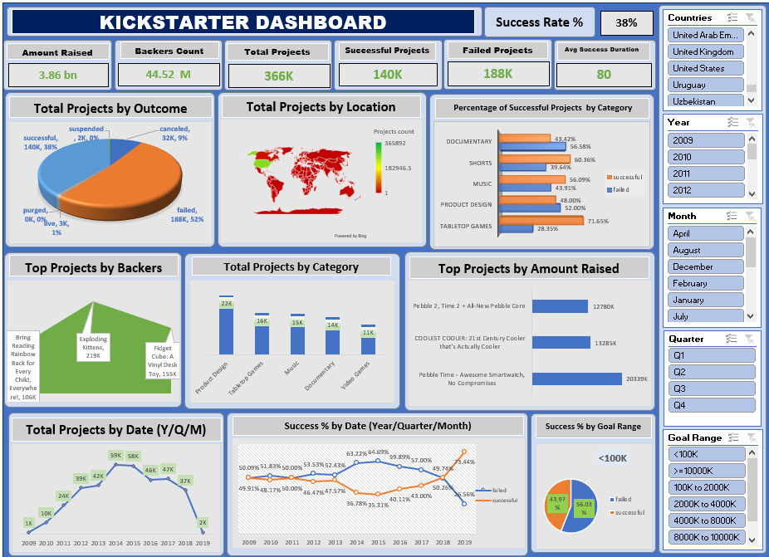
Kickstarter Analysis with Excel

Slide 15

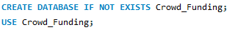



Kickstarter Analysis with MySQL
Database :
Load Data Into Calendar_Table:
Calendar_Table :

Slide 16


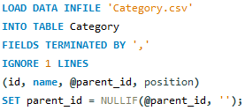
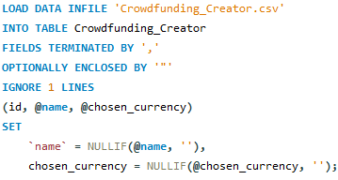
Category Table :
Crowdfunding_Creator Table :
Load Data Into Category Table :
Load Data Into Crowdfunding_Creator Table :

Slide 17
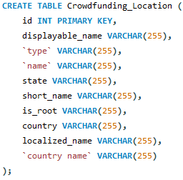
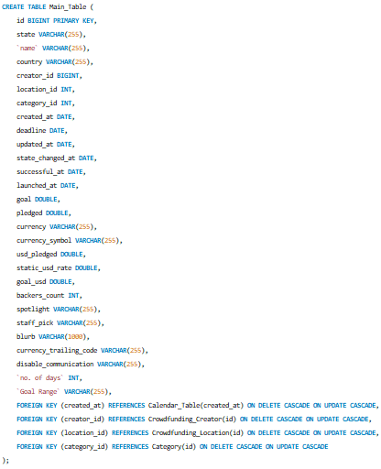
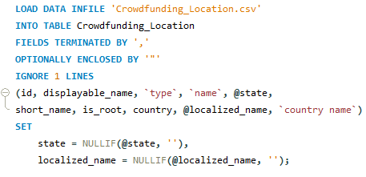
Crowdfunding_Location Table :
Main_Table :
Load Data Into Crowdfunding_Location Table :

Slide 18
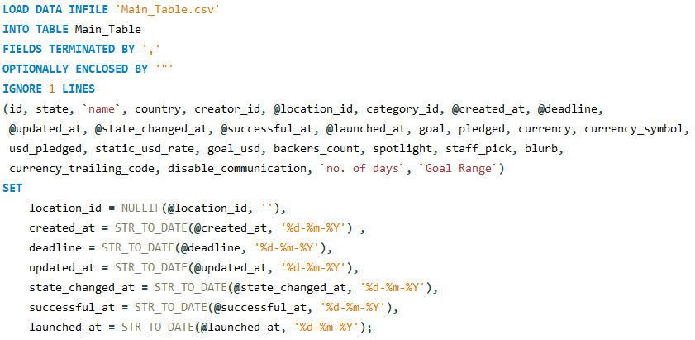
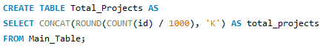
Load Data into Main_Table :
Total Number of Projects :

Slide 19
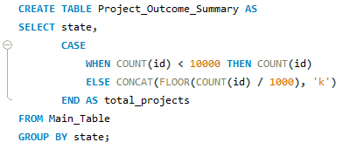
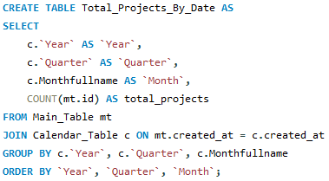
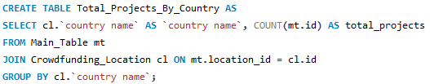

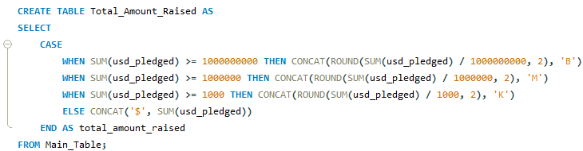
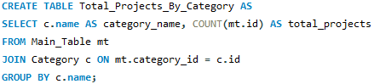
Total Number of Projects based on outcome :
Total Number of Projects created by Year , Quarter , Month :
Total Number of Projects based on Countries :
Successful Projects :
Amount Raised :
Total Number of Projects based on Category :

Slide 20
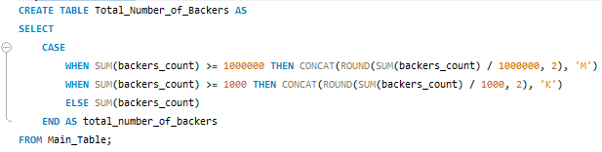
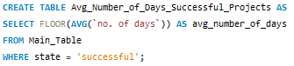

Number of Backers :
Avg Number of Days for successful projects :
Top Successful Projects based on Number of Backers :

Slide 21
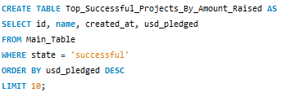
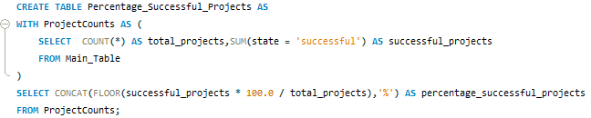

Top Successful Projects based on Amount Raised :
Percentage of Successful Projects overall :
Percentage of Successful Projects by Category :

Slide 22

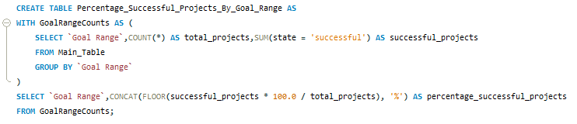
Percentage of Successful Projects by Year , Quarter, Month :
Percentage of Successful projects by Goal Range :

Slide 23
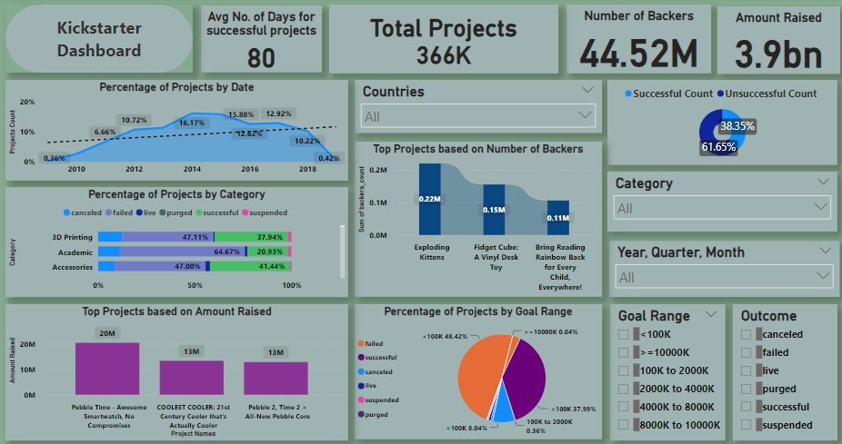
Kickstarter Analysis with Power BI

Slide 24
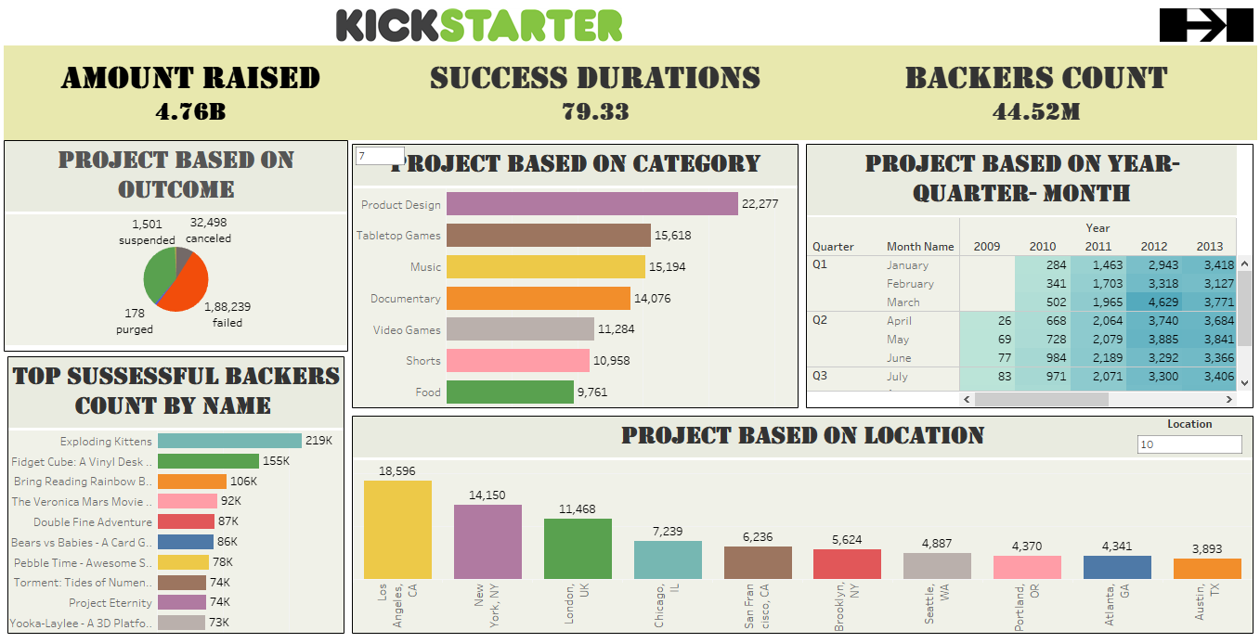
Kickstarter Analysis with Tableau

Slide 25
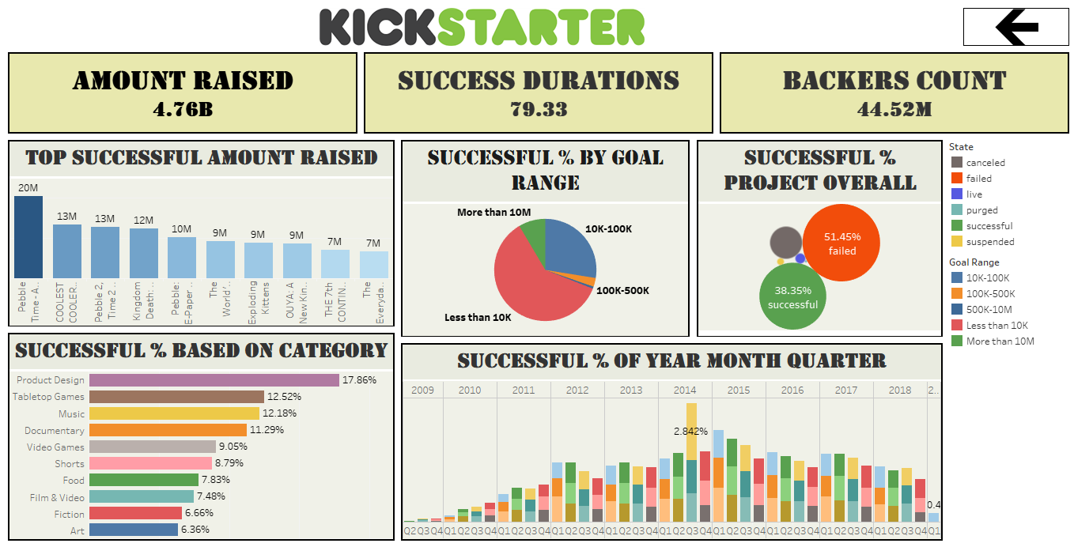
Kickstarter Analysis with Tableau

Slide 26
Main challenges identified
01. High Competition:
02. Funding Goal Setting:
03. Marketing and Promotion:
Many projects compete for the same pool of backers, making it difficult for new projects to gain visibility.
Setting unrealistic funding goals can lead to project failure.
Lack of effective marketing strategies results in low project reach and engagement.
.
.
.

Slide 27

Recommendations
Utilize social media and influencers to promote projects. Engage with the community through regular updates and interactive content.
Analyze similar successful projects to set achievable funding goals. Offer stretch goals to motivate backers.
Develop comprehensive marketing plans, including pre-launch campaigns. Use targeted ads to reach potential backers interested in similar projects.

Slide 28

Conclusion
Crowdfunding has seen substantial growth, with increasing numbers of projects and backers till 2015 year.
Effective marketing, realistic goal setting, and community engagement are crucial for project success.
Expect growth in crowdfunding, with technology and design projects leading the way. Increasing use of data analytics to tailor marketing strategies and improve success rates.
.
.

Slide 29
THANK YOU
SO MUCH!

